Slide 1

A Novel Approach for Age and Gender Detection using Deep Convolution Neural Network

Slide 2
01
Introduction

Slide 3
Abstract
This research paper proposes a novel approach for age and gender detection using a deep convolutional neural network (DCNN).
Using convolutional neural network (CNN).
Fine-tune a pre-trained DCNN on a large-scale UTKFace dataset evaluate its performance on the same.
The proposed approach in the study outperforms state-of-the-art methods in terms of accuracy and computational efficiency, as demonstrated by the results.

Slide 4
02
Proposed Methodology

Slide 5
Case presentation
Our proposed methodology for the research on gender and age prediction is to analyze an image and predict gender and age. For this deep learning research, image characterization and regression models were used. A convolutional neural network (CNN) was employed to extract image features, and plot graphs were used to display the outcomes.
We developed a regression model for predicting age and a gender prediction model based on image classification.

Slide 6
Data collection
23,700 photos
Using images of human faces, the research aims to determine a person’s gender and age
The presentation makes it easier to understand how age and gender were determined.
In terms of gender, one (1) is female and zero (0) is male.

Slide 7
Data preprocessing
The images are resized to a consistent width and height. Due to limited resources, we scaled each image in this study to 128 x 128.

Slide 8
Neural Network Architecture
Using 30 epochs we have defined our CNN architecture,composed of
An input Conv2D input layer (with 32 filters) paired with MaxPooling2D output layer. [13] (activation function ‘relu’ has been used to improve performance.)
Three pairs of Conv2D(with 64, 128 and 256 filters) and MaxPooling2D layers.
As there are two outputs (gender and age), two dense layers with 256 nodes each were defined.
Two output layers one for gender output and the other for age output.
Compiled the model with cross-entropy for binary classification.

Slide 9
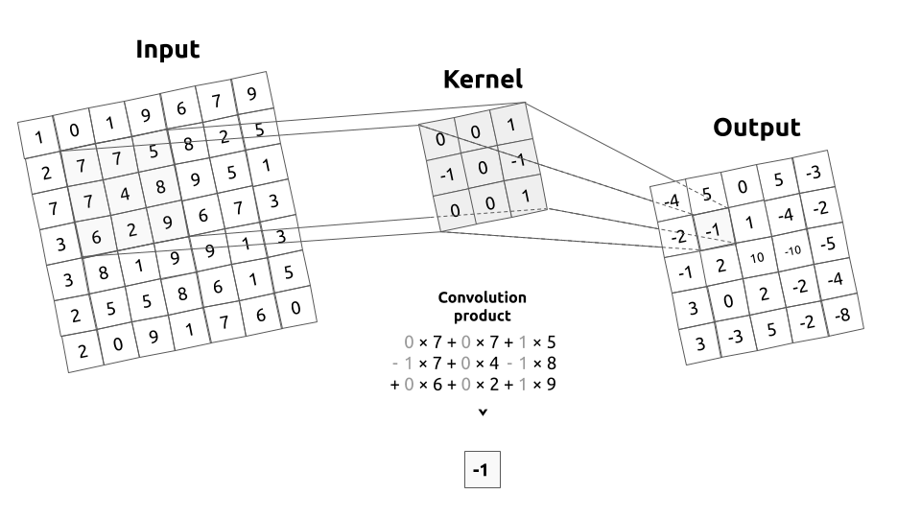
Conv2D layer
When an input image with a matrix size of [128, 128] passes through a Conv2D layer with a kernel size of 7x7 and 32 filters, the size of the output matrix depends on the settings of the Conv2D layer, including padding and stride.
If padding = “valid” and stride = 1, resulting in a final output tensor size of [122, 122, 32].

Slide 10
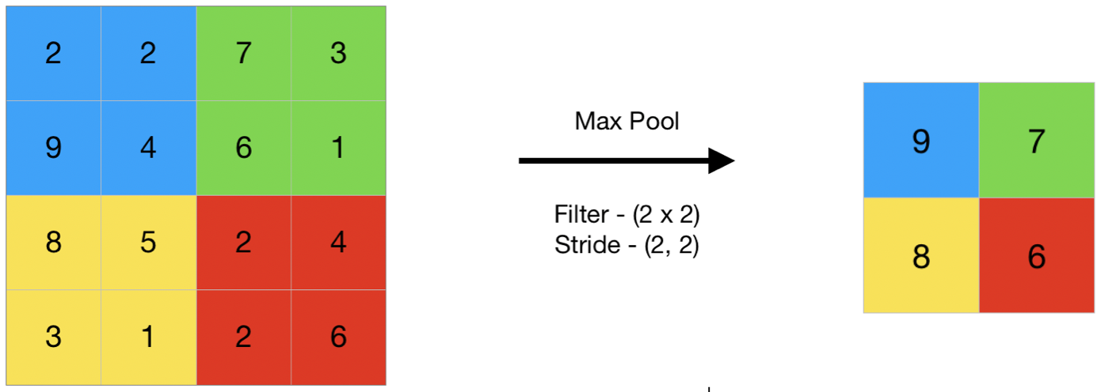
MaxPooling2D
The ReLU function is defined as:
f(x)=max(0,x)
Where:
x is the input value.
f(x) is the output value of the ReLU function.
The ReLU function sets the output value f(x) to zero if the input x is negative, and it keeps the input value x unchanged if
x is non-negative.

Slide 11
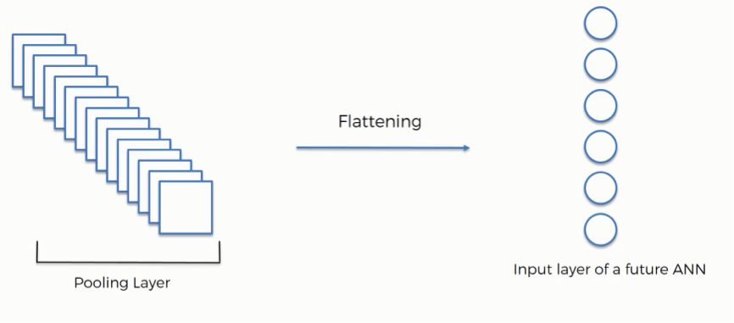
Flatten
Flattening is a process that converts the Multi-dimensional Pooled Feature map into One Dimensional vector.
For example, if the output from a convolutional layer is a feature map with dimensions [batch_size, height, width, channels], the Flatten layer will transform it into a one-dimensional vector with dimensions [batch_size, height * width * channels].

Slide 12
Fully connected layers
Following these convolutional layers, there are two dense layers with 256 nodes each. Dense layers are fully connected layers where each neuron is connected to every neuron in the previous layer. These layers help in learning high-level features from the extracted representations.
Finally, there are two output layers, one for gender output and the other for age output. These layers produce the final predictions of gender and age based on the features learned by the preceding layers.

Slide 13
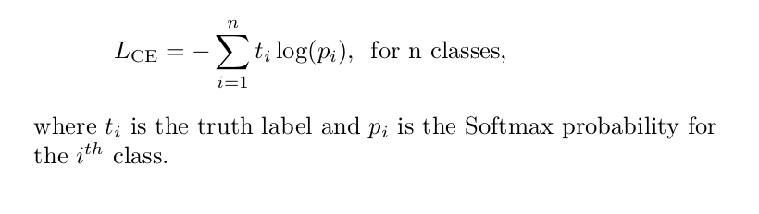
Model Compilation
Cross-entropy loss is commonly used in classification tasks and is particularly suited for problems where the output can be categorized into multiple classes (in this case, gender) or where there are two classes (binary classification).
It measures the difference between the predicted probability distribution and the actual distribution of the labels.

Slide 14
03
Experimental Result

Slide 15
Experimental Result
Using the UTKFace
dataset
The collection includes almost 23,000 face photos with comments for age, gender, and ethnicity.
Age and gender ranges [1] that can be anticipated include 0–2, (4- 6), (8–12), (15–20), (25–32), (38–43), (48–53), and (60–100).
Instead of RGB, [12] a
grayscale format is employed
to conserve processing resources. To prevent distortion, we downsized from 200x200 to 128x128.
Class Distribution according to age

Slide 16
Experimental Result
Using the UTKFace
dataset
In figure 2, we can observe the dispersion of the age
property. Most of them are between the ages of 25 and 30.
We can scale this distribution by using standard scalar (or)
min-max normalization.
Instead of RGB, [12] a
grayscale format is employed
Class Distribution according to age

Slide 17
Experimental Result
We used 20% of the 23000 images of men and
women for validation, while the remaining 80% were for training. After each of the 30 training cycles for the CNNs
models, the proportion of estimates in which the predicted value matches the real value was calculated. The number of epochs and batch size used for model training are
influenced by the hardware requirements. Each cycle increases training and validation accuracy. Training and validation losses are reduced with each repetition.
Gender classification from the data set

Slide 18
Experimental Result
Gender accuracy is nearly 90% -
the Mean absolute error of age is 6.5
These models were trained on the UTKface dataset, and we found that CNN 3 outperformed CNN 2 and CNN 1 in terms of results.
In CNN 3, we used three convolutional layers, but in CNN 2 and CNN 1, we only used two layers of convolution with different filter sizes.
In CNN 1, the first convolution layer was applied with 32 filters, while in CNN 2, the first convolution layer was applied with 64 filters, increasing system performance.
A convolutional network’s effectiveness is greatly influenced by the network’s depth and the number of its filters.

Slide 19
Experimental Result
In figure 4, we can see the growth in the accuracy of predictions made by the model while training.
Graph depicting the accuracy of prediction

Slide 20
Experimental Result
The validation loss shows how
efficiently the model fits new data, while the training loss
shows how well it matches the training data.
loss graph for gender prediction

Slide 21
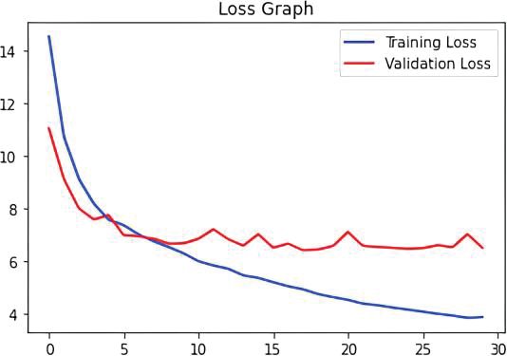
Experimental Result
Similarly, figure 6 depicts the loss graph for age detection.
loss graph for age prediction

